Slide 1
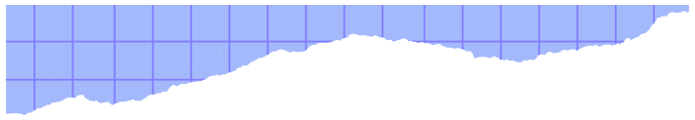




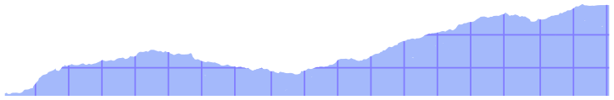
By Priyanshi
ZOMATO
CASE STUDY
Visualization Tool- Looker Studio

Slide 2
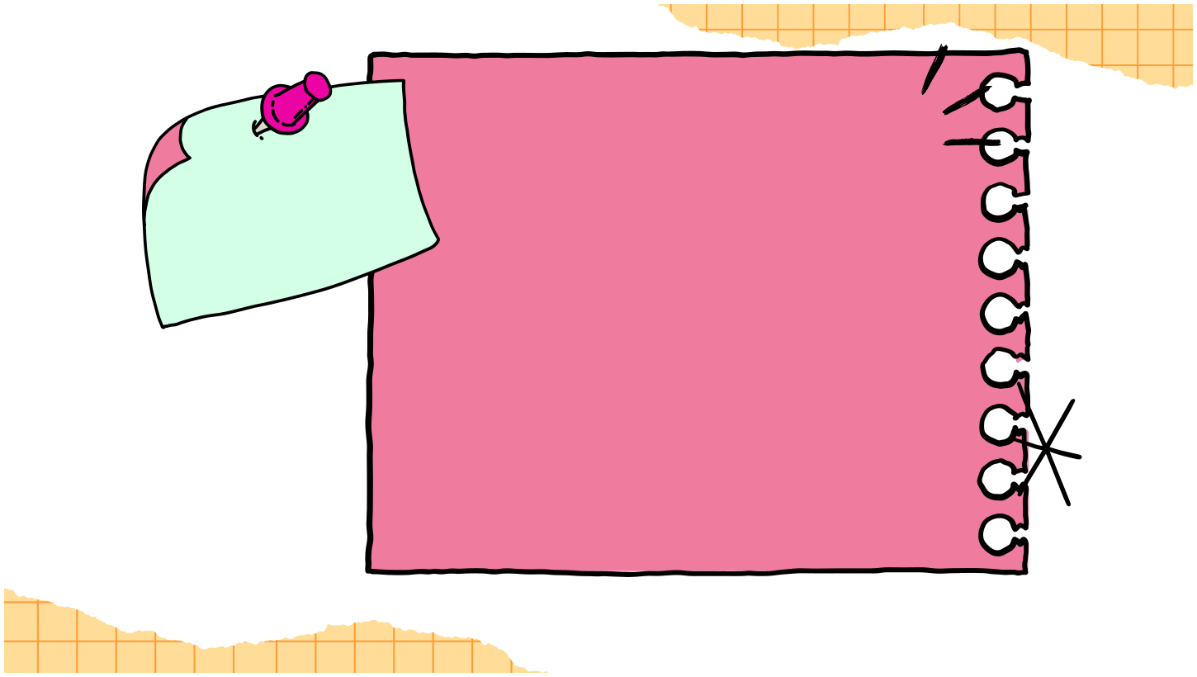

1.Introduction 2.Overview 3.Importance of Addressing the Issue
Agenda
4. KPIs
5. Key Insights
6. Dashboard
7. Suggestions

Slide 3
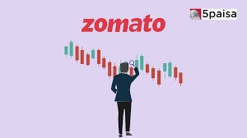



Introduction
Zomato is facing a decline in customer engagement, with increasing order cancellations and delivery delays.
Zomato, India’s leading food delivery platform, you are tasked with addressing challenges in customer satisfaction, fluctuating delivery times, and inconsistent sales across regions. Data shows a drop in repeat customers and high cancellations. Your mission is to analyze sales, ratings, and delivery data to uncover actionable insights that enhance customer experience, improve marketing strategies, and boost operational efficiency to drive growth.
Overview

Slide 4
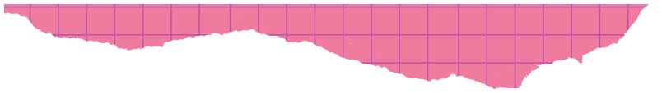
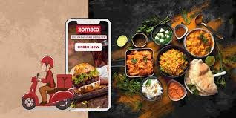
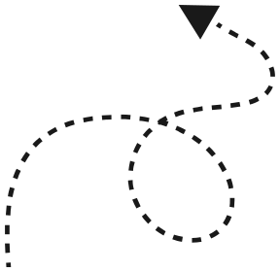
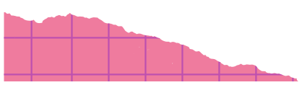
Importance of Addressing the Issue
1. Increase customer lifetime values,
2.Increasing customer retention
3. Reduced customer Acquisition Cost
(CAC)
4. Reducing Delivery time
5.Optimizing Restaurant
Recommendations

Slide 5
KPIs
Total Revenue: 585.8K
Average customer Rating: 2.97
Completed Orders: 344
Total Orders: 1000

Slide 6


Key Insightts:
Average Delivery Time by Cities
Cities like Bangalore (57.04) and Delhi (57) have the longest delivery times.
Chennai (48.47) and Kolkata (47.9) seem to have relatively faster delivery times.
Total Revenue
Revenue shows fluctuations, possibly due to seasonal trends or inconsistent order completion
rates.
Customer Rating by All Orders
Customer ratings are concentrated around lower scores, indicating dissatisfaction across many
orders.
Average Order Amount by Cuisine
Italian cuisine has the highest average order amount, while Chinese cuisine generates lower-
order value.
Payment Method Distribution
UPI and cash payments are most popular (around 50% combined), suggesting a preference for
flexible payment options.
The average order distribution by payment method
Indicates that customers predominantly prefer cash payments, with a total of 1,456 orders. This is followed by
credit card payments, which account for 1,345 orders. Both UPI and debit card payments show relatively lower
usage, with 1,323 and 1,311 orders, respectively.
Delivery Time by Order Status
Delivery delays are evident for failed or canceled orders, likely contributing to dissatisfaction.
Delivery Time by Cuisine Type
Certain cuisines, like Italian (10060) and Mexican (9226), have longer delivery times, potentially
impacting ratings and satisfaction

Slide 7
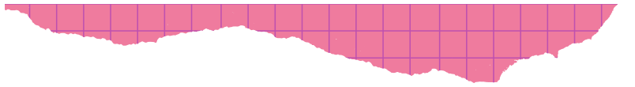
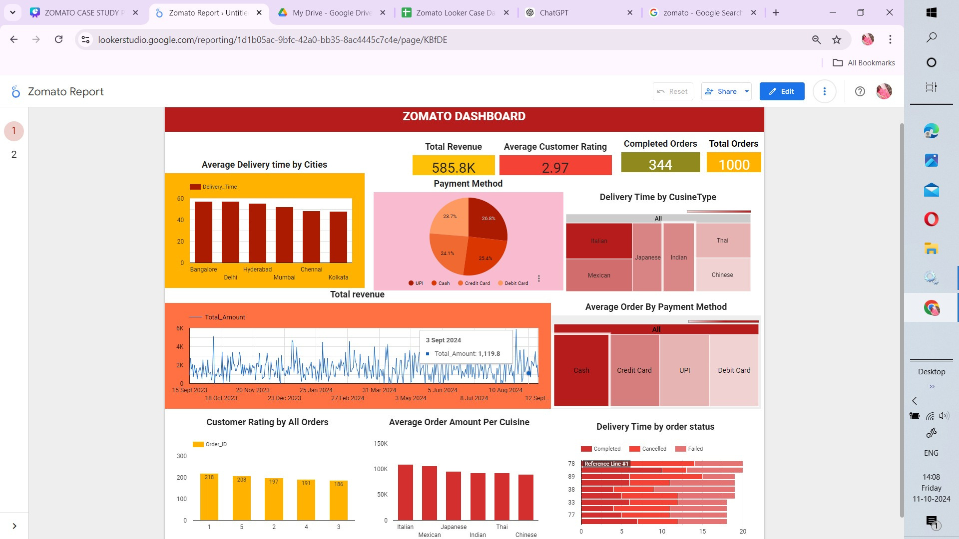

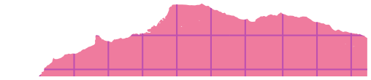

Slide 8
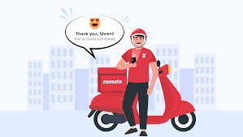
Suggestions:
Optimize Delivery Routes
Focus on reducing delivery times in Bangalore and Hyderabad by improving route planning, increasing delivery staff, and partnering with more local restaurants, check the frequency of orders on specific delivery partner.
Improve Customer Satisfaction
Address issues causing low ratings through better food packaging, faster delivery, and proactive customer support.
Monitor High-Value Cuisines
Prioritize faster delivery for high-value cuisines (e.g., Italian, Mexican and Japanese) to retain high-spending customers.
Enhance Payment Experience
Offer discounts or incentives for preferred payment methods (UPI and cash) to drive more engagement and trust.
Analyze Cancellations
Investigate the root causes of cancellations and failed deliveries, such as restaurant delays or miscommunication with customers.
Targeted Marketing
Use data to run city-specific marketing campaigns that highlight faster delivery or popular cuisines to boost engagement in underperforming areas.
Customer Feedback Loop
Implement a robust feedback system to identify recurring issues from customer reviews and ratings.

Slide 9
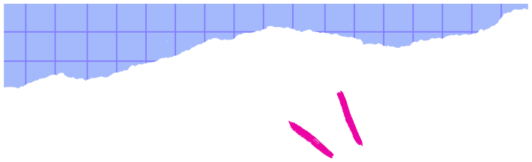
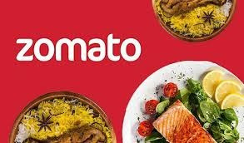



THANK YOU!
By priyanshi

